Slide 1
Command Pattern

Slide 2
Need to issue requests to objects without knowing anything about the operation being requested or the receiver of the request.
Notes:
06-01

Slide 3
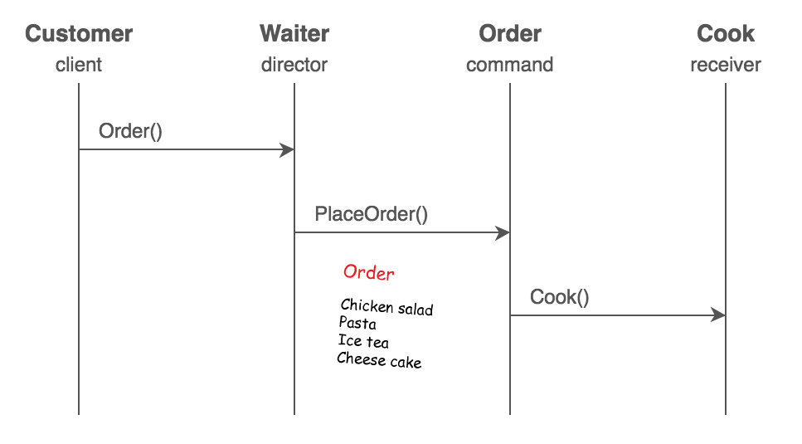
Notes:
06-00-01

Slide 4
customer order a meal
a meal include a burger and a drink
Notes:
06-00-02

Slide 5
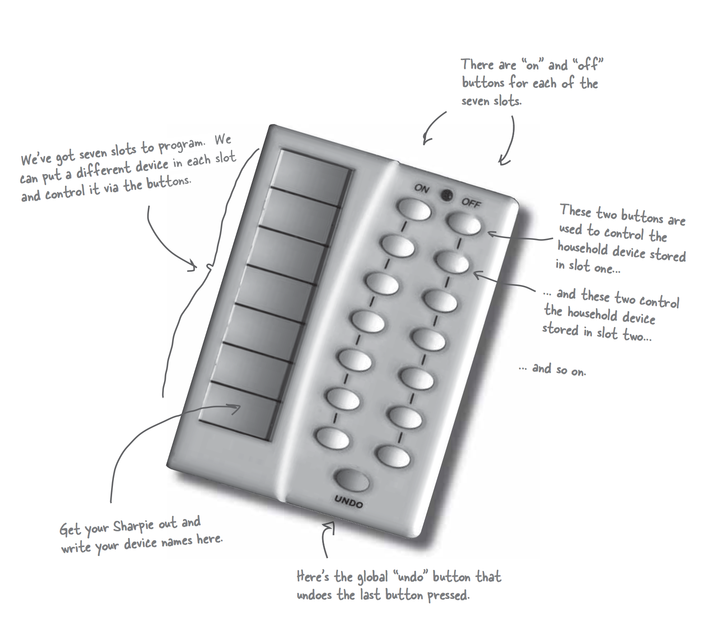
Notes:
Explain the book’s example

Slide 6
A remote control has one button when you click the button, a light is turned on.
Notes:
06-01

Slide 7
A remote control has two buttons when you click the “on button”, a light is turned on when you click the “off button” the light is turned off.
Notes:
06-02

Slide 8
A stereo can play CD, DVD, radio and adjust volume. Connect the stereo to the remote control. When clicking the "on button" the stereo is turned on, play CD, and volume is set to 11.
Notes:
06-03

Slide 9
Add location property to the light.
Notes:
06-04

Slide 10
Create two lights, one is in the living room, and the other is in the kitchen. Connect the two lights to the remote control.
Notes:
06-05

Slide 11
Add location property to the stereo.
Notes:
06-06

Slide 12
A Ceiling Fan has three speeds, "high", "medium", and "low". Connect it to the remote control. When clicking the "on button", the ceiling fan is turned on and its speed is high.
Notes:
06-07

Slide 13
Add undo function to the Command class.
Notes:
06-08

Slide 14
Implement the undo function with a previous state property.
Notes:
06-09

Slide 15
Implement a party mode to the remote control. When clicking the party mode button. The light, the tv, the stereo in the living room is turned on ,and the hot tub is turned on, set to 104 degrees, and circulate.
Notes:
06-10

Slide 16
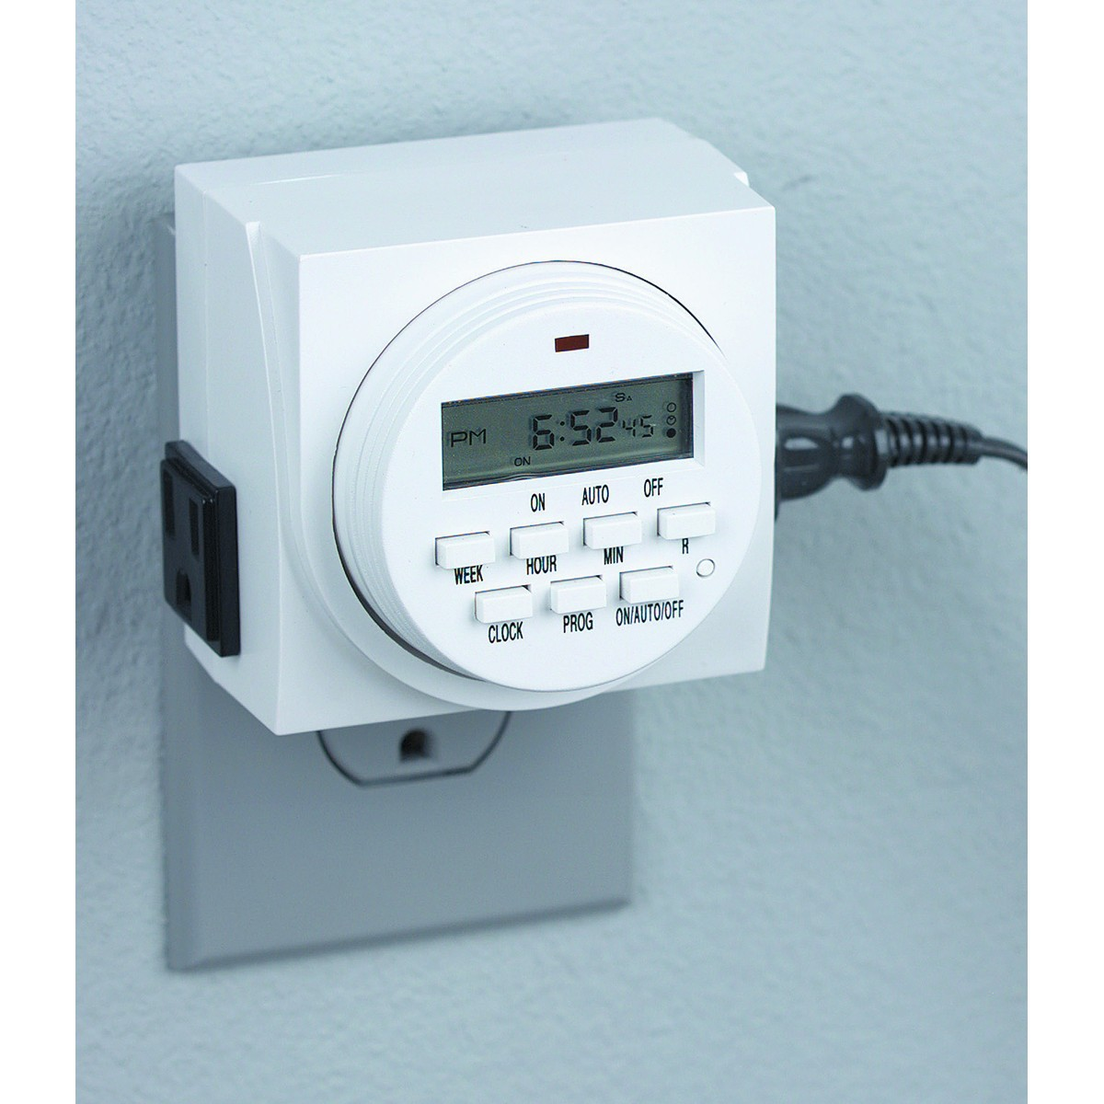
Notes:
06-11

Slide 17
Create a morning call function to the remote control. When clicking the "on button", the stereo will be turned on at 07:00.
Notes:
06-12

